Slide 1
Chapter 4: The von Neumann Model
Source:
Introduction to Computing Systems from bits & gates to C & beyond (McGraw-Hill, 2004)
COSC221: Computer Organization I

Slide 2
Topics for Discussion
Basic Components
The LC-3
Instruction Processing
Instruction Cycle Control
COSC221: Computer Organization I

Slide 3
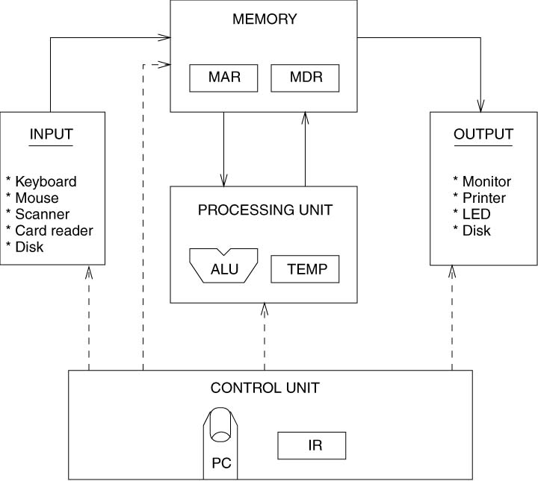
The von Neumann model
COSC221: Computer Organization I

Slide 4
Basic Components
Memory
Processing Unit
Input and Output
Control Unit
COSC221: Computer Organization I

Slide 5
Memory
Given n as the number of bits used to represent a unique memory address:
  Address space = 2^{n} uniquely identifiable locations
  Addressability = capacity of each memory location
    8 bits = 1 byte
MAR (memory’s address register): register used to specify the memory address to be read from or written into
MDR (memory’s data register): register used to store data read from or to be written into memory
COSC221: Computer Organization I

Slide 6
Processing Unit
Performs actual processing of information
May contain many functional units such as the ALU (arithmetic and logic unit)
  Word length: size of quantities normally processed by the ALU
  Word: refers to the element
    LC-3: 16-bit words
Also contains a small amount of storage (registers)
  LC-3: contains eight 16-bit registers
COSC221: Computer Organization I

Slide 7
Input and Output
Also referred to a peripherals
Input devices:
  Keyboard
  Mouse
  Digital scanners
  Floppy disks
Output devices:
  Monitor
  Printer
  Disks
COSC221: Computer Organization I

Slide 8
Control Unit
Keeps track of which instruction is being processed in the execution of a program and what part of an instruction is being executed
IR (instructions register): register contains the instruction to be executed
PC (program counter): register which contains the address of the next instruction
  Also called the instruction pointer
COSC221: Computer Organization I

Slide 9
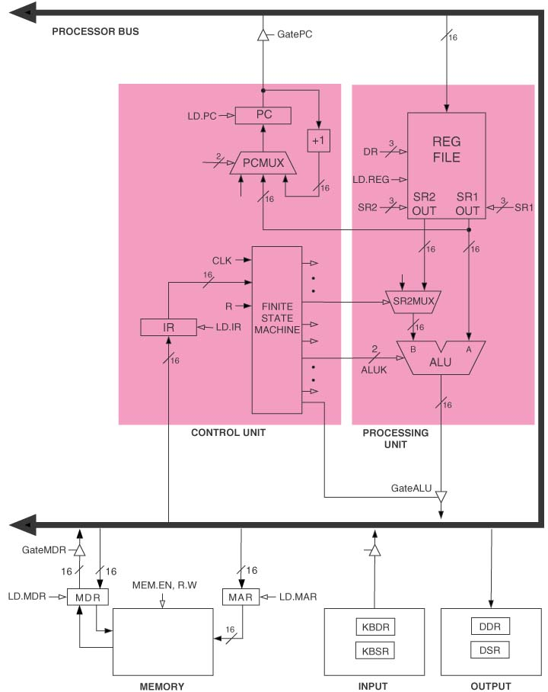
The LC-3
Notation:
Filled-in arrowheads
= flow of data elements
Hollow arrowheads
= flow of control signals
COSC221: Computer Organization I

Slide 10
The LC-3 continued
Memory
  MAR: 16-bit register
    Address space = 2¹⁶
  MDR: 16-bit register
    Addressability = 16 bits
Input/Output
  Input:
    KBDR: data register for holding ASCII for keys struck
    KBSR: status register for maintaining status info about the keys struck
  Output:
    DDR: data register for holding ASCII code to be displayed on the screen
    DSR: status register for maintaining associated status information
The Processing Unit
  ALU: performs ADD, bitwise AND and bitwise complement
  Eight 16-bit registers
The Control Unit
  Contains the finite state machine, which directs all the activity
  Processing is carried out one clock cycle at a time
  IR: contains LC-3 instruction is being processed
  PC: keeps track of the next instruction to be executed
COSC221: Computer Organization I

Slide 11
Instruction Processing
Program is executed one instruction at a time under the direction of the control unit
COSC221: Computer Organization I

Slide 12
The Instruction
Most basic unit of computer processing
Consists of two parts:
  Opcode: what the instruction does
  Operand(s): info to be used in processing the instruction
LC-3 instruction: 16 bits
  Bits [15:12] contain the opcode
    There are 2⁴ opcodes
  Bits [11:0] contain the operands
COSC221: Computer Organization I

Slide 13
The Instruction Cycle
The control unit processes instructions in a sequence of steps
  The sequence of steps is called the instruction cycle
  The steps are referred to as phases
Six phases of an instruction cycle
  FETCH
  DECODE
  EVALUATE ADDRESS
  FETCH OPERANDS
  EXECUTE
  STORE RESULT
COSC221: Computer Organization I

Slide 14
FETCH
Using the PC, fetches the next instruction from memory and loads it in the IR
  Value of PC is loaded in the MAR, increment PC
  Content of address in MAR is stored in MDR
  Value in MDR is loaded into IR
Each step could take one or more machine cycles
COSC221: Computer Organization I

Slide 15
DECODE
Examines the instruction to figure out what needs to be done
EVALUATE ADDRESS
Computes the address if the memory location needed to process the instruction
FETCH OPERANDS
Obtains the source operands needed to process the instruction
COSC221: Computer Organization I

Slide 16
EXECUTE
Carries out the execution of the instruction
STORE RESULT
Result is written to its designated destination
The instruction cycle repeats from the FETCH phase.
COSC221: Computer Organization I

Slide 17
Types of Instructions
Operate Instructions
  Processes data
  Example: ADD
Data Movement Instruction
  Moves data from one place to another
  Example: LDR
Control Instruction
  Used to exchange the sequence of instruction execution
  Example: JMP
  Value of PC controls the sequence
COSC221: Computer Organization I

Slide 18
Instruction Cycle Control
Value of PC controls the sequence
Stopping the Computer
  Control unit will repeat instruction processing sequence
  as long as clock is running.
    If not processing instructions from your application,
    then it is processing instructions from the Operating System (OS).
    The OS is a special program that manages processor
    and other resources.
  To stop the computer:
    AND the clock generator signal with ZERO
    When control unit stops seeing the CLOCK signal, it stops processing.
COSC221: Computer Organization I

Slide 19
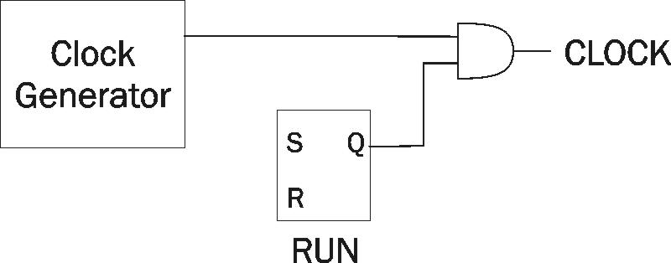
The Clock Circuit and Its Control
COSC221: Computer Organization I

Slide 20
Reading Assignment
Chapter 5 The LC-3
COSC221: Computer Organization I

